Slide 2
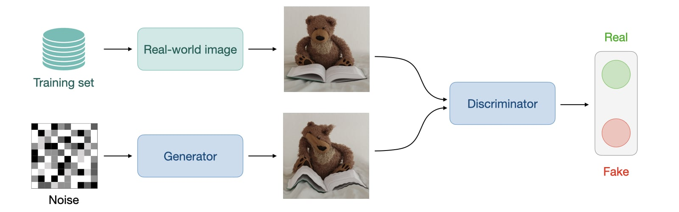
Generative Adversial Networks (GAN)
Like VAE a Generative Adversial Network is a generative learning approach, hence you try to model a distribution (instead of a probability) as close as possible to your data to sample from it. Training a GAN is completly different from what we have seen so far.

Slide 3
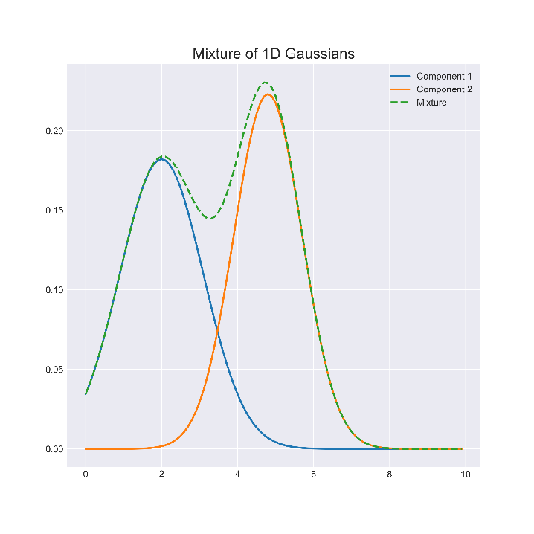
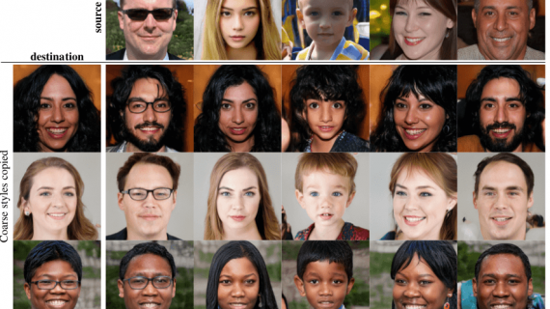
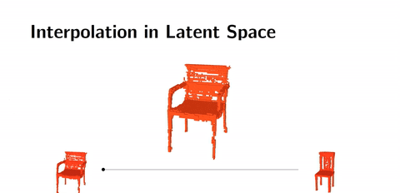
Generative Adversial Networks (GAN)
Since GAN models a distribution, we can use this to do latent space arithmetics (similar of adding gausian distributions) and sample from this new continuous space, with some funny results.

Slide 4

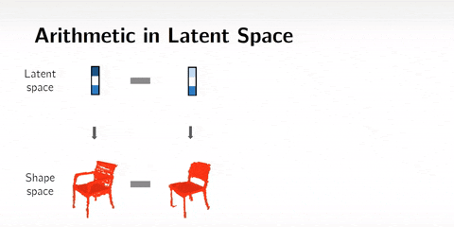
Generative Adversial Networks (GAN)
We can also do style transfer!
Style transfer with Ron Swanson (Deepfakes)

Slide 5
12. Exercise Let‘s train our first GAN!

Slide 6
Recurrent Neural Networks
TBD

Slide 7
BidirectionalRNN
TBD

Slide 8
Sequence to Sequence Model
TBD

Slide 9
Attention
TBD

Slide 10
Transformer Attention is all you need
TBD

Slide 11
13. Exercise Let‘s train our first RNN on IMDB!

